Slide 1

CSCI/ARTI 8950 Machine Learning
Lecture Notes 7: Perceptron
Khaled Rasheed
Professor
School of Computing
Member
Institute for Artificial Intelligence
University of Georgia
Credit: some examples & figures by Marine Carpuat, Tom Mitchell and CIML

Slide 2
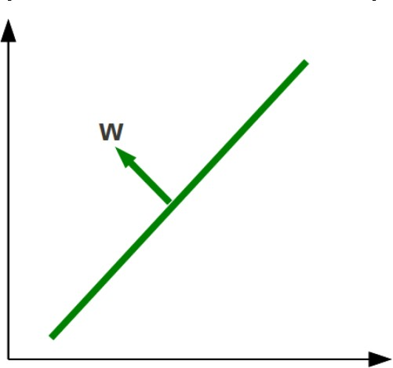
Geometry concept: Hyperplane
Separates a D-dimensional space into two half-spaces
Defined by an outward
pointing normal vector 𝑤 ∈ _{ℝ}𝐷
– 𝑤 is orthogonal to any vector lying on the hyperplane
Hyperplane passes through the origin, unless we also define a bias term b

Slide 3
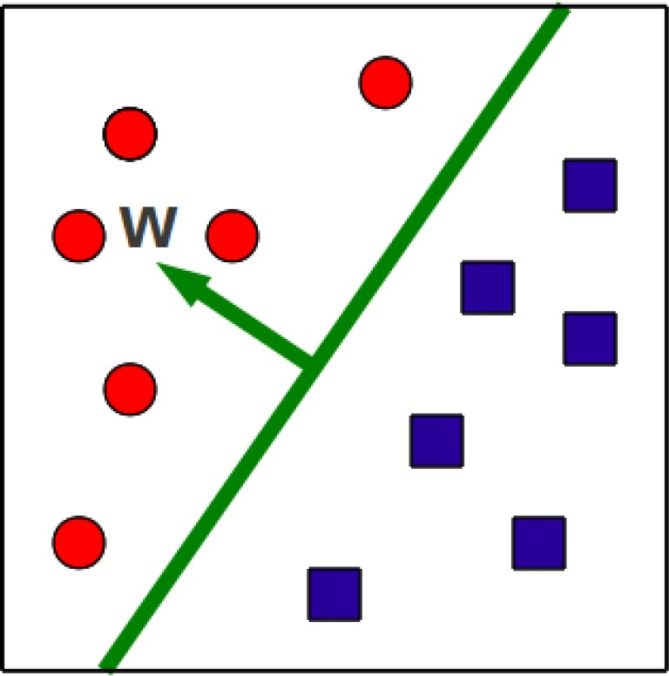
Binary classification via hyperplanes
Let’s assume that the decision boundary is a hyperplane
Then, training consists in finding a hyperplane 𝑤 that separates positive from negative examples

Slide 4
Binary classification via hyperplanes
At test time, we check on what side of the hyperplane examples fall
𝑦 = 𝑠𝑖𝑔𝑛(𝑤^{𝑇}𝑥 + 𝑏)

Slide 5
Function Approximation with Perceptron
Problem setting
Set of possible instances 𝑋
Each instance 𝑥 ∈ 𝑋 is a feature vector 𝑥 = [𝑥₁, … , 𝑥_{𝐷}]
Unknown target function 𝑓: 𝑋 → 𝑌
𝑌 is binary valued {-1; +1}
Set of function hypotheses 𝐻 = ℎ ℎ: 𝑋 → 𝑌}
Each hypothesis ℎ is a hyperplane in D-dimensional space
Input
Training examples { 𝑥 ¹ , 𝑦 ¹
target function 𝑓
Output
, … 𝑥 ^{𝑁} , 𝑦 ^{𝑁} } of unknown
Hypothesis ℎ ∈ 𝐻 that best approximates target function 𝑓

Slide 6
Math review: The dot Product
Given two vectors u and v their dot product u . v is ∑_{d} u_{d} ⋅ v_{d}
Suppose $\left\|u\right\|$= 1, so that u is a unit vector
We can think of the vector v as consisting of two components:
a is a component perpendicular to u
And b is a component in the direction of u
The length of b is exactly u . v
The dot product is therefore
the projection of v onto u
In general the dot product is the Cosine of the angle between the two vectors multiplied by their Euclidean norms

Slide 7


Perceptron Structure
Model is an assembly of nodes connected by weighted links
Output node sums up its input values according to the weights of their links
Output node sum then compared against some threshold t
Input nodes
X
Output node
y = I (
∑
w_{j} x _{j} − t)
1
or
j
X₂
Y
y = sign(∑ w x − t)
Σ
j j
X₃
j
t

Slide 8
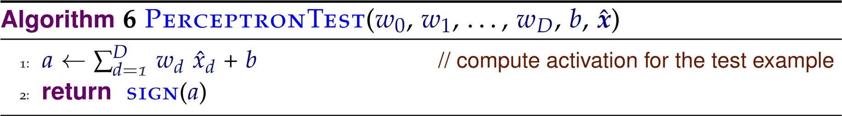
Perception: Prediction Algorithm

Slide 9
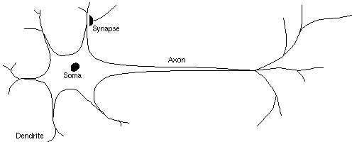
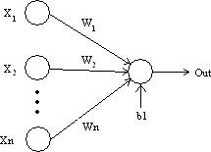
Aside: biological inspiration
Analogy: the perceptron as a neuron

Slide 10
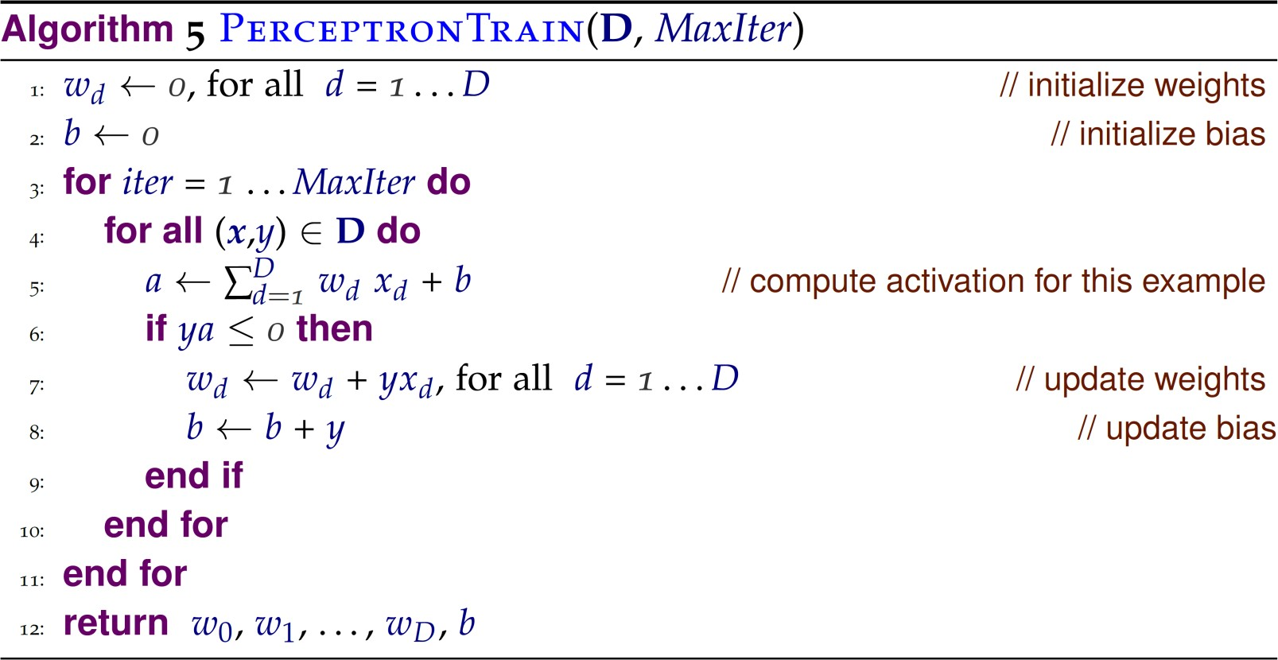
Perceptron Training Algorithm

Slide 11
Example: Modeling a Boolean Function
X₁ | X₂ | X₃ | Y
1 | 0 | 0 | 0
1 | 0 | 1 | 1
1 | 1 | 0 | 1
1 | 1 | 1 | 1
0 | 0 | 1 | 0
0 | 1 | 0 | 0
0 | 1 | 1 | 1
0 | 0 | 0 | 0
Input
X₁
Black box
Output
Y
X₂
X₃
Output Y is 1 if at least two of the three inputs are equal to 1.

Slide 12
Example: Modeling a Boolean Function
Input nodes
X₁ | X₂ | X₃ | Y
1 | 0 | 0 | 0
1 | 0 | 1 | 1
1 | 1 | 0 | 1
1 | 1 | 1 | 1
0 | 0 | 1 | 0
0 | 1 | 0 | 0
0 | 1 | 1 | 1
0 | 0 | 0 | 0
Output node
X
1
0.3
X₂
0.3
Y
Σ
X₃
0.3
t = 0.4
y = I (0.3x₁ + 0.3x₂ + 0.3x₃ > 0.4)
if z is true
⎩0 otherwise
where I ( z) = ^{⎧1}
⎨

Slide 13
Properties of the Perceptron training algorithm
Online
We look at one example at a time, and update the model as soon as we make an error
As opposed to batch algorithms that update parameters after seeing the entire training set
Error-driven
We only update parameters/model if we make an error

Slide 14
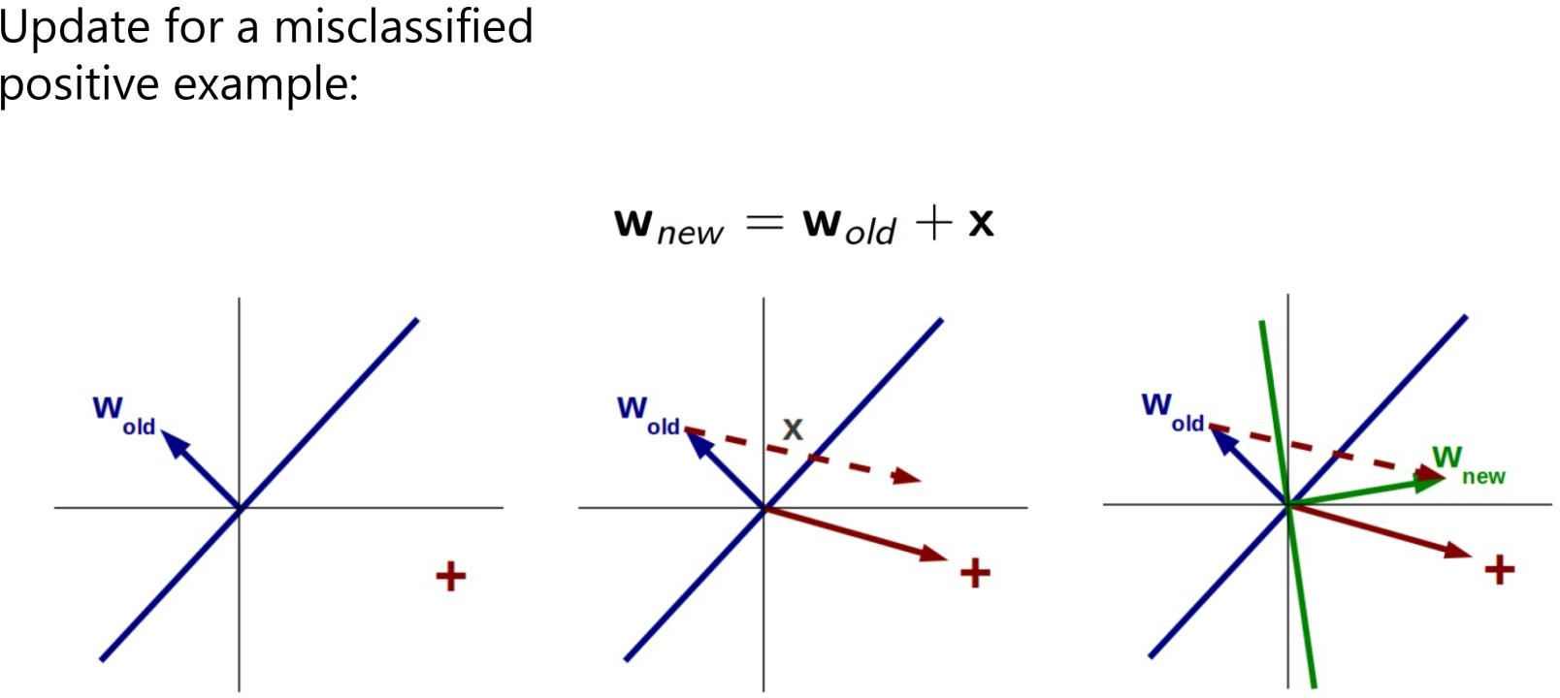
Perceptron update: geometric interpretation

Slide 15
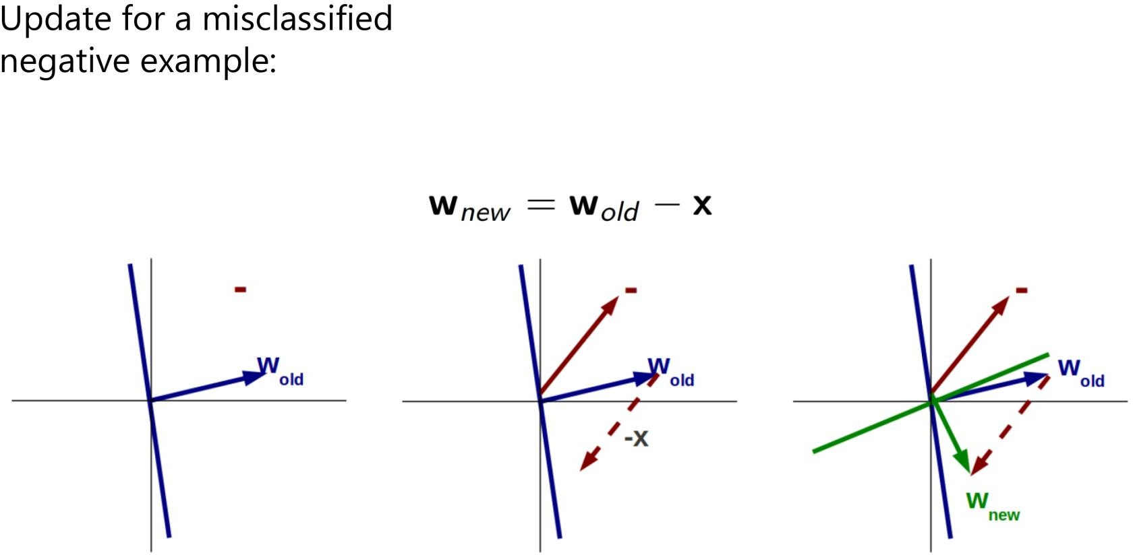
Perceptron update: geometric interpretation

Slide 16
Practical considerations
The order of training examples matters!
Random is better
Early stopping
Good strategy to avoid overfitting
Simple modifications dramatically improve performance
voting or averaging

Slide 17
Standard Perceptron: predict based on final parameters

Slide 18
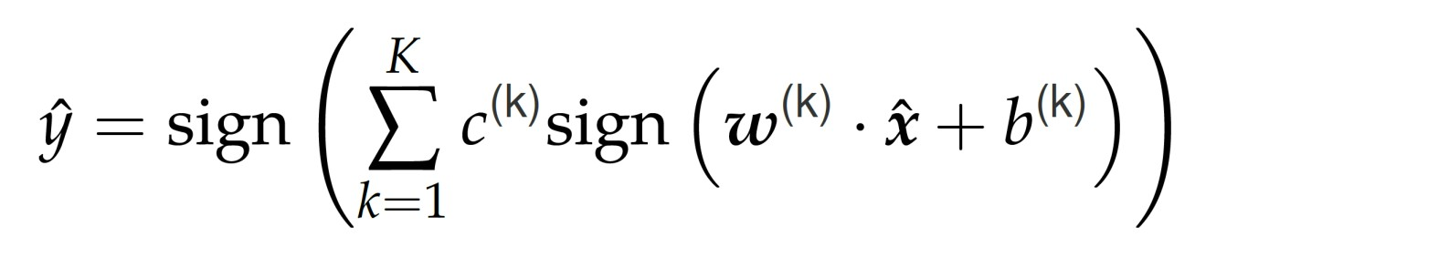
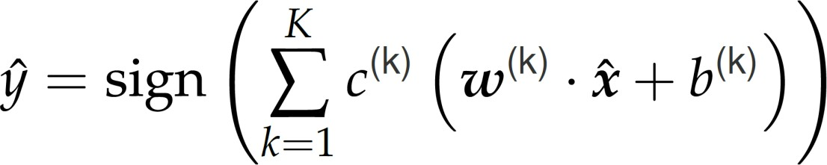

Predict based on final + intermediate parameters
The voted perceptron
The averaged perceptron
Require keeping track of “survival time” of weight vectors

Slide 19
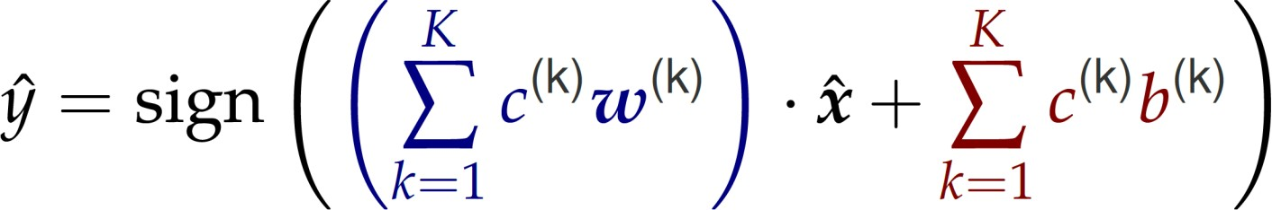
Averaged perceptron decision rule
can be rewritten as

Slide 20
Recap: Perceptron for binary classification
Classifier = hyperplane that separates positive from negative examples
𝑦 = 𝑠𝑖𝑔𝑛(𝑤^{𝑇}𝑥 + 𝑏)
Perceptron training
Finds such a hyperplane
Online & error-driven

Slide 21
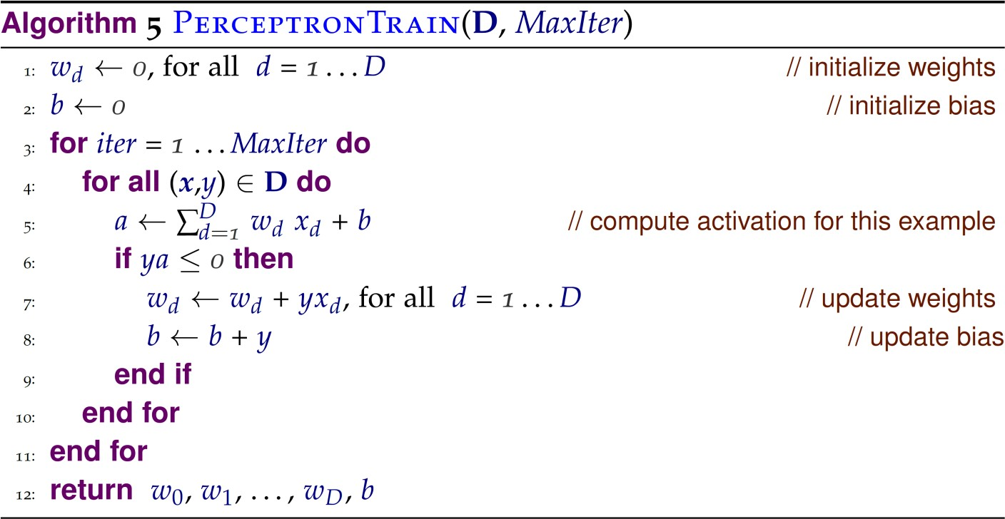
Standard Perceptron: predict based on final parameters

Slide 22
Can the perceptron always find a hyperplane to separate positive from negative examples?

Slide 23
Convergence of Perceptron
The perceptron has converged if it can classify every training example correctly
– i.e. if it has found a hyperplane that correctly separates positive and negative examples
Under which conditions does the perceptron converge and how long does it take?

Slide 24
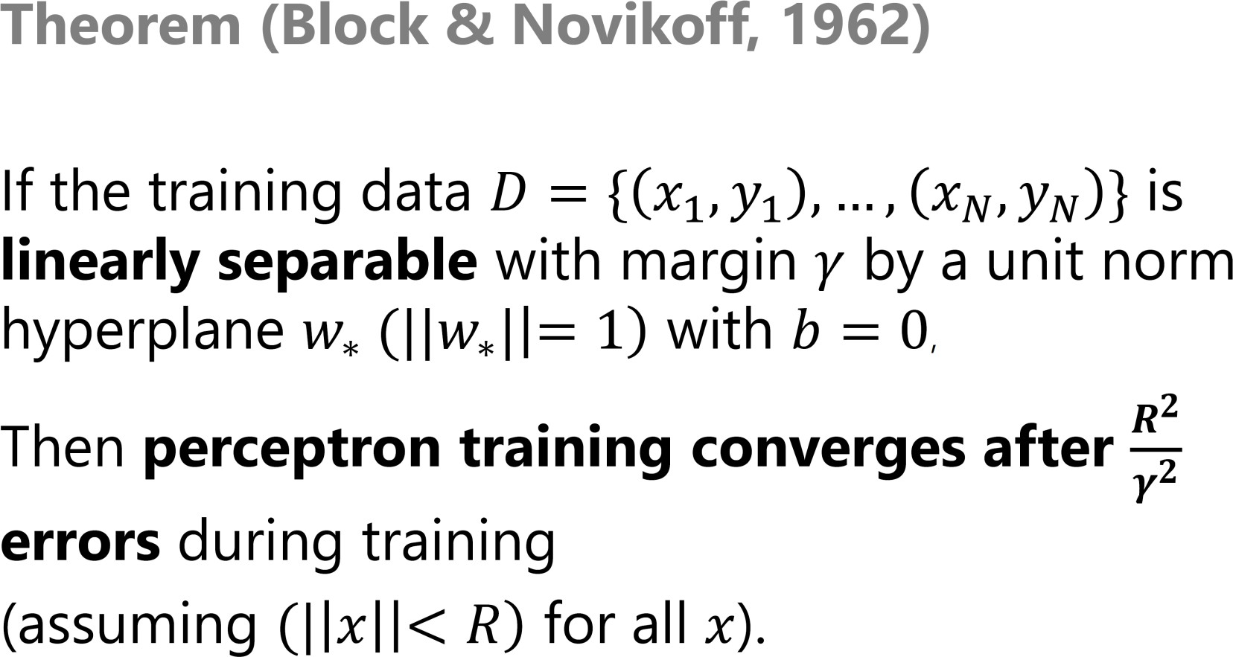
Convergence of Perceptron

Slide 25
Margin of a data set D
Distance between the hyperplane (w,b) and the nearest point in D
Largest attainable margin on D

Slide 26

From (1) we get that:
because has a unit norm
Combining this with (2) leads to:
$$k≤ \frac{R2}{γ2}$$

Slide 27
What does this mean?
Perceptron converges quickly when margin is large, slowly when it is small
Bound does not depend on number of training examples N, nor on number of features
Proof guarantees that perceptron converges, but not necessarily to the max margin separator

Slide 28
Practical Implications
Sensitivity to noise
if the data is not linearly separable due to noise, no guarantee of convergence or accuracy
Linear separability in practice
Data frequently linearly separable in practice
Especially when number of features >> number of examples
Risk of overfitting mitigated by
Early stopping
Averaging

Slide 29
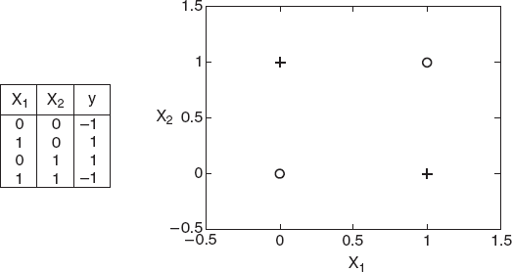
Expressiveness of Perceptron
Can model any function where positive and negative examples are linearly separable
Examples: Boolean AND, OR, NAND, NOR
Cannot (fully) model functions which are not linearly separable.
Example: Boolean XOR

Slide 30
What you should know
Perceptron concepts
training/prediction algorithms (standard, voting, averaged)
convergence theorem and what practical guarantees it gives us
how to draw/describe the decision boundary of a perceptron classifier
Fundamental ML concepts
Determine whether a data set is linearly separable and define its margin
Error driven algorithms, online vs. batch algorithms

